Slide 1
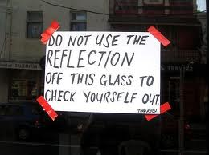
Critical Evaluation and Reflection
Notes:
Welcome to this presentation on Critical Evaluation and Reflection.
So, why is Reflection important?
Why – because we can review learnt activities, and give future learning a new meaning.
To better process our experiences and understand what we have learnt.

Slide 2
Reflection versus Evaluation
Reflection is the process of reflecting on your experience in order to learn from that experience, ie remembering what you experienced.
Evaluation is the process of making an assessment or judgement about an experience, ie judging what worked and/or what didn’t.
“It is difficult to evaluate an experience without reflecting on that experience.” (Johnson, 2015)
Notes:
Reflection is the process of reflecting on your experience in order to learn from that experience, basically remembering what you have experienced. A good example could be: “That was a good book I read yesterday,”.
Evaluation is the process of making an assessment or judgement about an experience, for example, judging what worked and/or what didn’t. An example here would be: Was that book valuable to me.? What did I learn from it?”
Johnson says that “It is difficult to evaluate an experience without reflecting on that experience.” - do you agree.
Reflection - “That was a good book I read yesterday,”.
Evaluation would ask “Was that book valuable to me.? What did I learn from it?”

Slide 3
Reflection versus Evaluation
Reflecting is about pondering a past experience
Evaluating is about finding the value in that experience.
Notes:
Though they may seem similar, Reflections and Evaluations are not the same thing.
For example, it is possible to reflect on an experience and not evaluate it.
As I’m sure you’ve noticed by now, there are plenty of people who will often recount something from the past (let’s say a group of friends reflecting on growing up in the same neighborhood) but never evaluate that experience as to what was good or bad or what they learned from it or how it changed their lives.

Slide 4
Write down …
5 things you could improve on.
5 positives about yourself, and
Notes:
Lets do a little exercise.
Write down 5 positives about yourself,
And 5 things that you could improve on
The 5 positives things means that you have reflected about the positive elements,
but the 5 things you could improve on equates to evaluating on things that you can improve, meaning that you have learnt from the experience, and have identified areas to improve.

Slide 5
If critical thinking is the process of understanding the external (ie questioning ideas, arguments and findings), then reflection is the process of understanding the internal. (This does not mean we don’t critically think when reflecting)
When we reflect we examine an experience or event we have had and ask questions about it.
“When we reflect, we consider deeply something that we might not otherwise have given much thought to.”
(Atkins and Murphy, 1994)
Notes:
If critical thinking is the process of understanding the external, for example questioning ideas, arguments and findings, then reflection is the process of understanding the internal. (This does not mean we don’t critically think when reflecting)
When we reflect we examine an experience or event we have had, and ask questions about it.

Slide 6

What is Reflection?
“Reflection is part of learning and thinking. We reflect in order to learn something, or we learn as a result of reflecting, and the term ‘reflective learning’ emphasises the intention to learn from current or prior experience.”
(Moon, 2004)
Notes:
Moon’s definition of Reflections is “Reflection is part of learning and thinking. We reflect in order to learn something, or we learn as a result of reflecting, and the term ‘reflective learning’ emphasises the intention to learn from current or prior experience.”
Reflection is a type of thinking aimed at achieving better understanding and leading to new learning.

Slide 7
Reflective Writing is …
Your response to experiences, opinions, events, new information, thoughts and feelings
A way of exploring your learning
An opportunity to gain self-awareness
A way to gain clarity and a deeper understanding of what you are learning
A chance to develop writing skills
Helps to examine lines between theory and practice
Reflective writing is not a summary of activities
Notes:
Reflective writing is evidence of reflective thinking.
It is your response to experiences, opinions, events, new information. It is your response to thoughts and feelings.
It is a way of thinking to explore your learning, and a way of making meaning out of that you study or do.
It is a way to achieve clarity and better understanding of what you are learning, an opportunity to gain self knowledge, and a chance to develop and reinforce writing skills
Reflective writing is not a summary of activities

Slide 8
The benefits
Increases self-awareness
Develops emotional intelligence
Encourages active engagement in work/learning
Develops ideas
Helps keep track of our thoughts
Helps us to learn new skills
Helps develop confidence
Notes:
The benefits include:
It increases self-awareness, and helps to transform experience into learning.
It helps us to develop our ideas and thinking, track our thoughts and enable us to learn new skills, and develop confidence.

Slide 9
How is it similar to core academic writing?
It requires research and development
It focuses on answering the question
It involves critical thinking and analysis
The structure is the same (introduction, main body, conclusion)
Requires good grammar and sentence structure
Notes:
It is similar to academic writing, it that it
Required research and development.
It focuses on answering the questions.
It involves critical thinking and analysis
The structure of your writing still needs an introduction, main body, and a conclusion
And good grammar and sentence structure is essential.

Slide 10
How does it differ from academic writing?
The use of 1st person is appropriate
It tends to link theory with practice
It connects with personal feelings and behaviour
It can be informal and formal
Notes:
Reflective writing can be written in the first person, and you can use words like ‘I’, and ‘we’.
It connects with personal feelings and behaviour, and it can be informal, but when writing as part of an assignment then it should be written in a formal manner.
And, it links theory to practice.

Slide 11
Reflecting helps us to understand …
What we have experienced
Why it happened the way it did
How we could have done things differently
So what? – how we can apply what we have learnt to future experiences
Notes:
Reflection helps us to understand what we have experienced, and why it happened the way it did.
How we could have done things differently, and how we can apply what we have learnt to future experiences.

Slide 12
“It is not sufficient simply to have an experience in order to learn. Without reflecting upon this experience it may quickly be forgotten, or its learning potential lost. It is from the feelings and thoughts emerging from this reflection that generalisations or concepts can be generated. And it is generalisations that allow new situations to be tackled effectively.”
(Gibbs, 1988)
Notes:
As Gibbs suggests: it is … …

Slide 13
How?
Write in the first person, eg I saw that …
Use the past tense (as you are referring to a particular moment that has past)
Be personal, hypothetical, critical and creative. You can comment based on your experiences, integrating them with academic evidence
Notes:
So, how do I write using this method.
Firstly, you write in the first person, using I and We.
Use the past tense, because are writing about something that has already happened.
And be personal, hypothetical, critical and creative. Do talk about your experiences, and integrate academic evidence into your writing.

Slide 14
Five questions to guide
What worked?
What didn’t?
What did I learn?
What could I do differently next time?
What will I do differently next time?
Notes:
For me, personally, I like to use five questions to guide my Reflection and Evaluation time.
But you can follow a model too

Slide 15

Why use a model?
It helps you to structure your reflection in a meaningful way
It keeps you focused
So that you can learn from your experiences and not just describe what happened
It enables you to think about future practice / activities
Notes:
A reflective module provides a framework for you to review your own performance with a view to understand your performance in a meaningful way.
It keeps your focus, so that you can learn from your experiences, rather than describing what happened.
It enables you to think about future practice, and activities.

Slide 16
Models – two examples – but there are others
Gibbs Reflective Cycle
Driscol (by Borton) three elements of reflection
Notes:
Here are two examples of Reflective models – but there are more. Feel free to investigate others frameworks

Slide 17
Driscol (by Borton) 3 elements of reflection
Description (What?)
What happened?
What is being examined?
Interpretation (So what?)
What is most important/ interesting about the topic?
How can it be explained?
How is it similar to and different from others?
Outcome (Now what?)
What have I learned from this?
What does this mean for my future?
Notes:
Another simple model was developed by Driscoll in the mid-1990s. Driscoll based his model of the 3 What's on the key questions asked by Terry Borton in the 1970s:
What? So what? Now what?
Driscoll (by Borton) (nottingham.ac.uk)

Slide 18
Driscol (by Borton) 3 elements of reflection
What.. (is the purpose of this situation)
So what.. (were you feeling at the time)
exactly occurred
did you see/do
was your reaction
did other people do
do you see as the key elements of this situation
are you feeling now.. the differences
were the effects of what you did/did not do
good emerged from the situation
what were your experiences compared to your colleagues
are the main reasons for the differences
are you going to do about the situation
needs to happen to alter the situation
might you do differently
are the best ways of getting further info about the situation should it happen again.
Now what.. (are the implications for you)
Notes:
By asking ourselves these three simple questions we can begin to analyse our experiences and learn from them.
Firstly we should describe what the situation or experience was to set it in context. This gives us a clear idea of what we are dealing with.
We should then reflect on the experience by asking 'so what?' - what did we learn as a result of the experience?
The final stage asks us to think about the action we will take as a result of this reflection. Will we change a behaviour, try something new or carry on as we are?
It is important to remember that it may be that nothing changes as a result of reflection and that we feel that we are doing everything we should during an experience. This is equally valid as an outcome and you should not worry if you can't think of something to change.

Slide 19
The Reflective Cycle (Gibbs 1988)
Description What happened?
Feelings What were you feeling?
Evaluation What was good / bad?
Analysis What sense can you make of it.
Conclusion What else could you have done?
Action Plan What would you do next time?
Notes:
Gibb's Reflective Cycle
This model builds on the previous model, and adds more stages. It is one of the more complex models of reflection but it may be that you find having multiple stages of the process to guide you reassuring.
Gibb's cycle contains six stages as seen in this diagram.

Slide 20
The Reflective Cycle (Gibbs 1988)
Description
What are you going to reflect on? Where was I? Why was I there?
Feelings
How was I feeling at the beginning?
What was I thinking about?
What did other people’s actions make me think/feel?
How did I feel about the outcome?
What do I think about it now?
Evaluation
What was good about the experience for me?
Analysis
What was bad about the experience for me?
“Breaking it down”. What did I do well / not so well?
What did others do well?
Did it go as expected? Why/why not?
Use theory to aid understanding and show how it relates to your reflection.
Action Plan
Could I have done anything differently?
What would I do in a similar situation in the future?
What aspects of my knowledge / skills could I develop? How will I do this?
What goals can I set myself for the future?
What outcomes / competencies do I need to focus on now?
What are the key things I have learned –about me, my performance, others and their performance?
What was I doing? What happened?
(provide a balanced assessment of the situation)
(link theory to practice to help you make sense of the situation)
Conclusion
Notes:
Gibb's begins with an outline of the experience being reflected on.
It then encourages us to focus on our feelings about the experience, both during it an after.
The next step involves evaluating the experience - what was good or bad about it from our point of view?
We can then use this evaluation to analyse the situation and try to make sense of it.
This analysis will result in a conclusion about what other actions (if any) we could have taken to reach a different outcome.
The final stage involves building an action plan of steps which we can take the next time we find ourselves in a similar situation.

Slide 21
Misconceptions
“reflection takes too long and I don’t have the time”
“reflection is a negative process”
Reflection can be done on the spot by just thinking about a few questions, such as what is working well? What am I or others struggling with? Do I or others understand the task? However this doesn’t mean rush! The key to reflection is slowly and systematically thinking about things.
Reflection is not just the process of identifying what can be improved, it is also a process of recognising what you did well.
Notes:
Here are two misconceptions about reflection. Do you agree that reflection takes too long, and that it is a negative process. Personally, I believe that you can learn plenty by the process of reflecting. I feel that it is invaluable, helpful, and essential.

Slide 22
Some ideas of what to reflect upon (Driscoll 2007)
Something that went really well was….
What drove me mad about the situation was…
What worked well that I hadn’t tried before was…
A recurring pattern I have noticed in practice is...
Something that concerns me is…
There seems to be a contradiction between what I am supposed to do and the way I do it….
What really puzzled me about today was….
If I had the chance to do that again….. I would….
I felt really stupid about….
Notes:
Here are some ideas for you to reflect on. Do take the time to read this slide for ideas

Slide 23
Reflective writing is still academic
It is not a diary entry, blog or email to a friend.
It is not simply a description of events. Reflection is in the analysis of those events. It is the considered exploration of your own role in the experience.
It should not be chatty in style.
It should still contain a clear introduction, a main body, and a conclusion.
It should include evidence and references.
It should be clearly linked to theory.
It should show what you have learned from the process.
It should consider other perspectives
Notes:
Reflective writing is still academic writing, it is not a diary entry, blog or email.
It is not simply a description of events. It is in the critical analysis of those events. It is the considered exploration of your own role in the experience.
It should not be chatty in style, and it should still contain a clear introduction, a main body, and a conclusion.
It should include evidence and references, and be linked to theory.
It should show what you have learned from the process, and it should consider other perspectives
Academic reflective writing requires critical and analytic thought, a clear line of argument, and the use of evidence through examples of personal experiences and thoughts, and often also theoretical literature.
You should aim for a balance between personal experience, tone, and academic practice and rigor.

Slide 24
Perhaps most importantly, critical reflection should be thought of not as an event or even as a skill, but as a process – of looking back on what you did, pondering about it and learning lessons from what did or did not work (Conway, 1994). The principle is that good practitioners do not simply do things; rather, they continually learn, develop and grow their abilities (Jarvis, 1992).

Slide 25
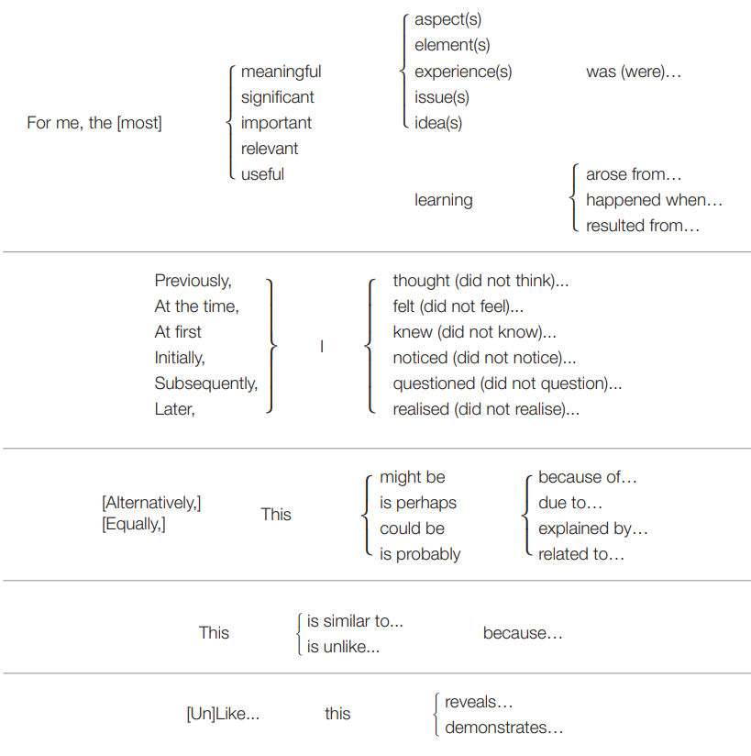
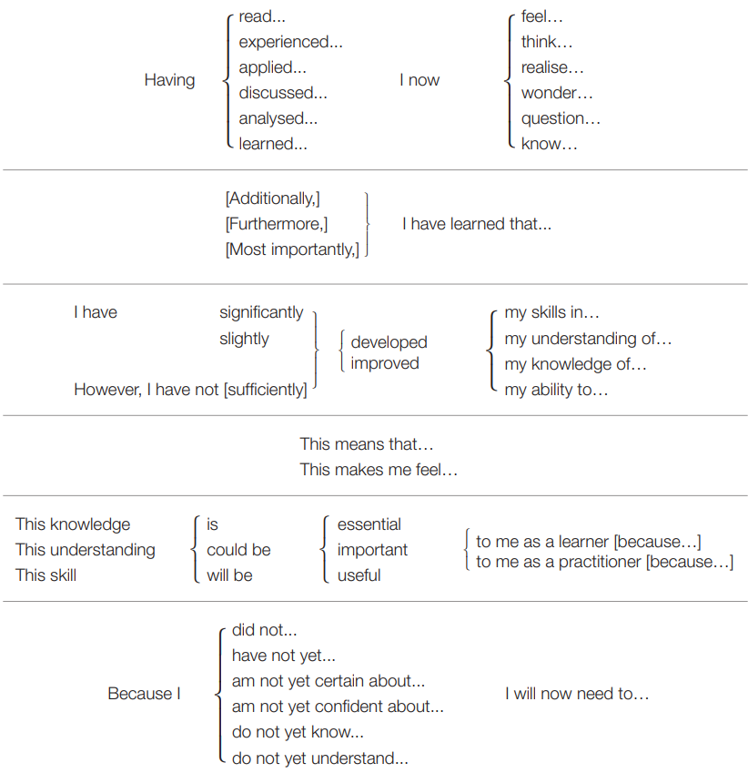
Vocabulary
University of Portsmouth Guide

Slide 26
Remember Reflection is not just recounting a story or experience!

